Slide 1

VOICE RECOGNITION AND EMAIL BASED HOME AUTOMATION SYSTEM USING RASPBERRY PI
APURVA PANIDHAR 2210411204
DN GAURAV RAJ 1210411114
PATLURI SRI CHAITANYA 2210411246
SAHITHI MANAM 2210411252
UNDER THE GUIDANCE OF:
Mr. B. SAMMUNAYAK _{M.Tech}
ASSISTANT PROFESSOR
GITAM UNIVERSITY
HYDERABAD CAMPUS

Slide 2
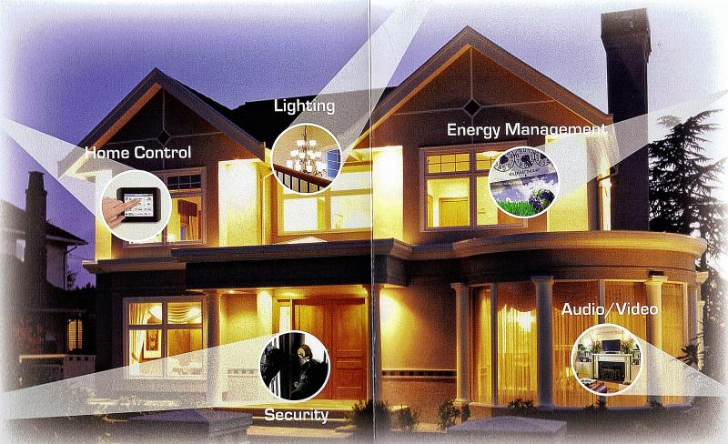
HOME AUTOMATION
Automation of household activities or centralized control

Slide 3
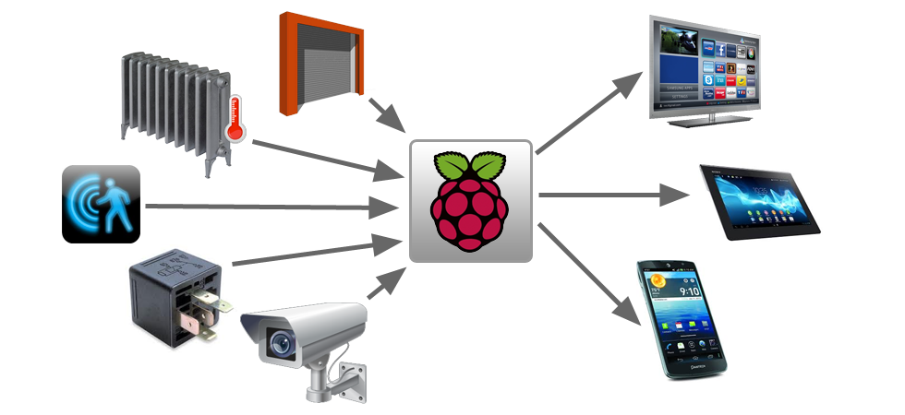
PROJECT AREAS OF FOCUS
Home automation with raspberry-pi at the crux
Voice recognition system
Email based system

Slide 4
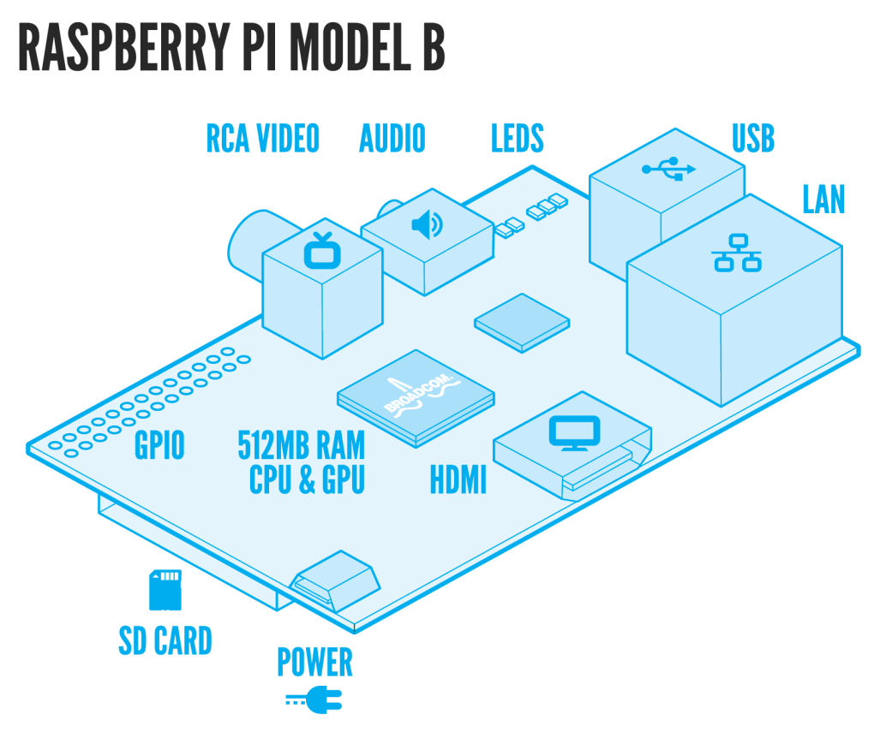
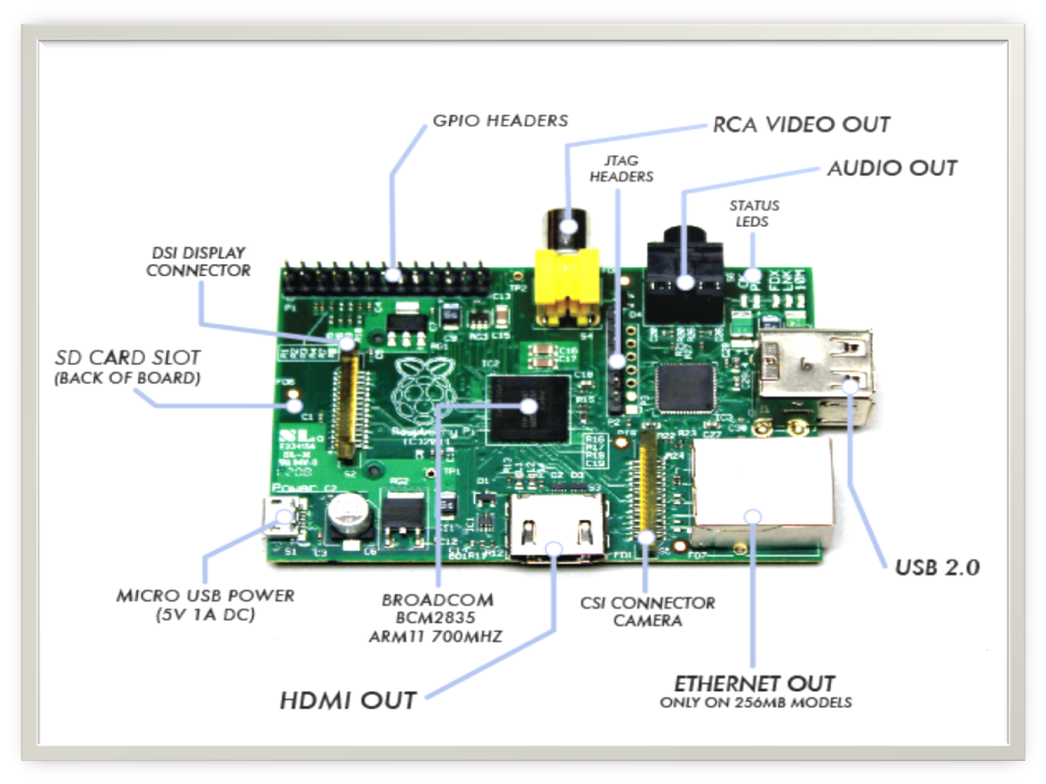
RASPBERRY PI-1
Developed in UK by Raspberry-pi foundation in 2009.
supported by “University of Cambridge Computer laboratory & Broadcom”
Credit card size single board ,super low cost computer
The Foundation has produced two models

Slide 5
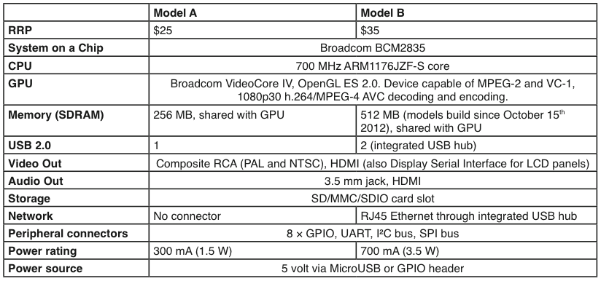
RASPBERRY PI-2

Slide 6
RASPBERRY PI-3
Advantages
Lower power consumption
Low cost
Small size
Applications
Home Automation System
Security System
HD surveillance system
Media Center
GPIO based

Slide 7
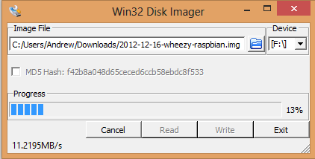
Installing Linux on Raspberry Pi
Download the Raspbian Image file from Raspberry Pi official page.
Write the image file on to a SD Card and insert the SD Card in to RPi.

Slide 8
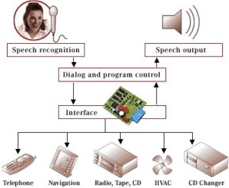
VOICE RECOGNITION SYSTEM-1
Enables user to control home appliances with voice commands when in the home
Implies that the system can only take dictation and not understand words
So you talk and your electronics listen!

Slide 9
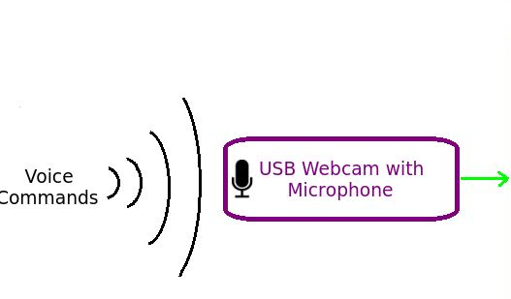
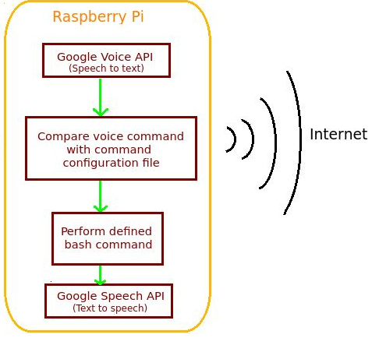
VOICE RECOGNITION SYSTEM-2
Jasper
An open source platform to develop voice controlled applications
A software similar to Siri in iOS

Slide 10
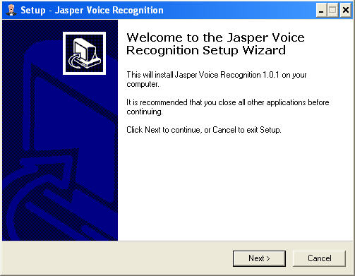
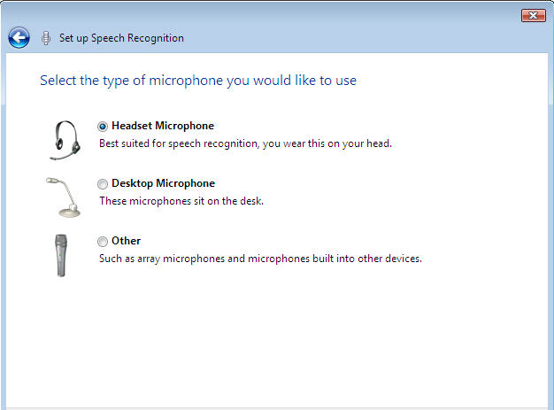
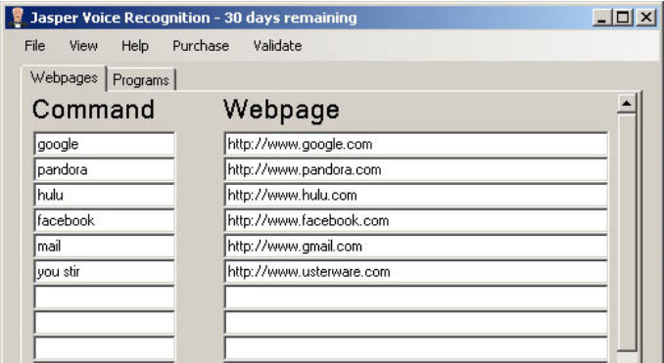
Jasper Installation and Working

Slide 11
Voice Recognition
Voice Recognition is done in many ways. But Google Speech Service API is preferred for its accuracy. It is basically divided in to 4 parts
1. Speech to Text
2. Query Processing
3. Text to Speech
4. Combining them Together

Slide 12
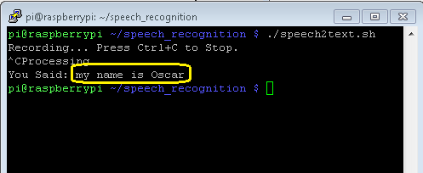
Speech to Text
Install fmpeg
Use “speech2text.sh” bash script to convert incoming speech to text

Slide 13
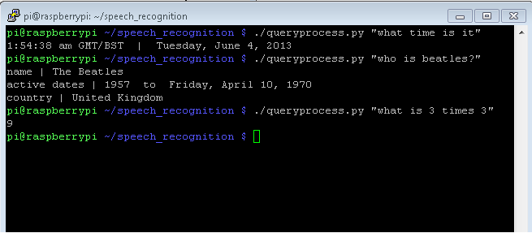
Query Processing
Query Processing is similar to asking a question on google. But in this case, only one answer is returned.
To do this WolframAlpha Python Library is used

Slide 14
Text to Speech
From the processed query, we are returned with an answer in text format. To convert this text in to audio. Google Speech Service is used “text2speech.sh“ is used for this purpose.
Google Service limits the length of message to 100 characters. To work around this, an upgraded bash script that breaks up the text into multiple parts so each part is no longer than 100 characters, and each parts can be played successfully.

Slide 15
Combining them together
To combine all the scripts together. A main script is used called “main.sh”
Execute the “main.sh” and all the scripts work together to answer the queries spoken by the user.

Slide 16
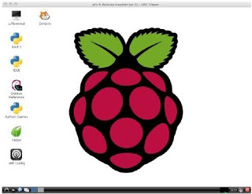
RESULTS
After installing linux, we will get the following window.

Slide 17
THANK YOU!

